Slide 1
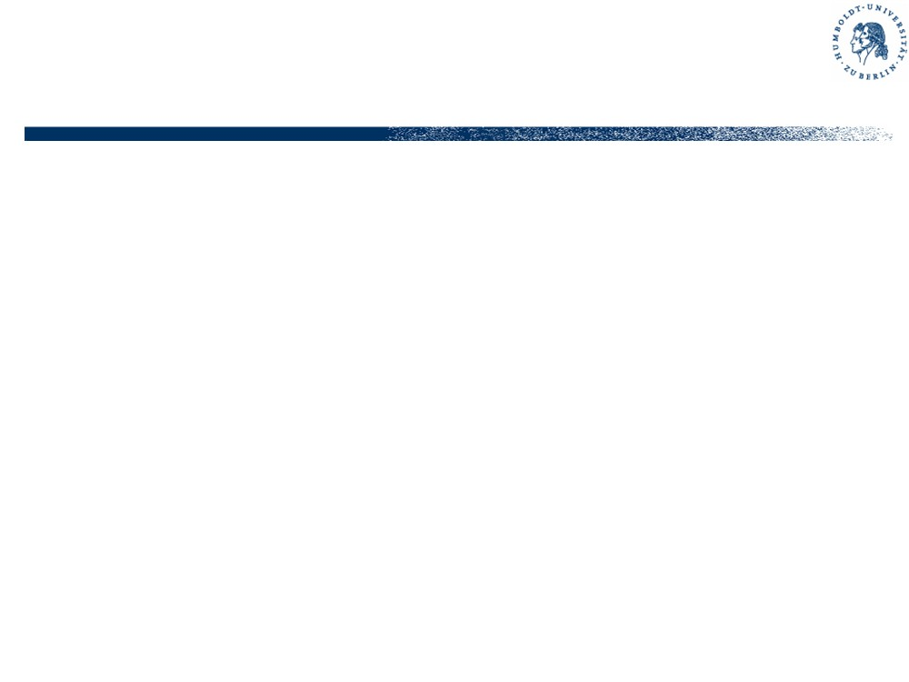
Basic of software testing
§ Introduction
- Motivation, definitions, …
- Topics, classification, tools
§ Paul Jorgensen-Examples
- The triangle problem
- The NextDate function
- The commission problem
- The automated teller machine
- The currency converter
- The windshield-wiper controller

Slide 2
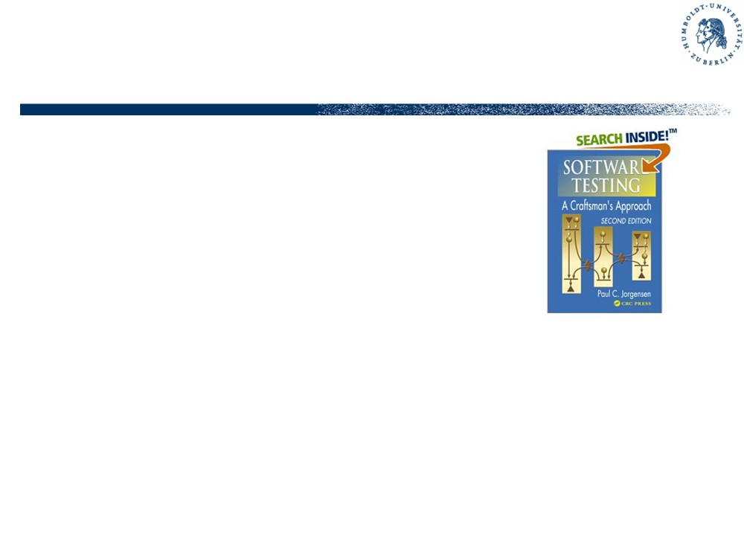
Literature
• P.C. Jorgensen: Software Testing, a Craftsman‘s Approach. 2nd ed., CRC Press 2002
(3rd ed. announced for 2007)
• A.P. Mathur: Foundations of Software Testing. Purdue
University, 775 pp., to appear 2007
• G.J. Myers: The Art of Software Testing, Wiley 1979
• J.A. Whittaker: Software: A Practical Guide to Testing, Addison-Wesley 2002
• R.V. Binder: Testing Object-oriented Systems -
Models, Patterns and Tools, Addison-Wesley 1999

Slide 3
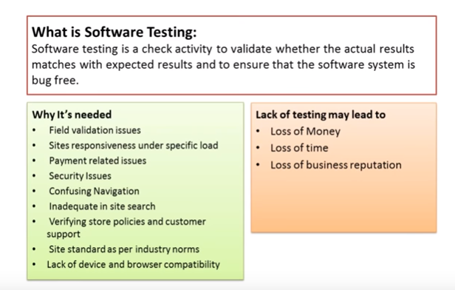

Slide 4
Software Testing : Definition
“The process of devising a set of inputs to a given piece of software that will cause the software to exercise some portion of its code.
The developer of the software can then check that the results produced by the software are in accord with his or her expectations.”
Software testing is a process used to identify the correctness, completeness and quality of developed computer software.
Actually, testing can never establish the correctness of computer software, as this can only be done by formal verification (and only when there is no mistake in the formal verification process). It can only find defects, not prove that there are none.”

Slide 5
Some Software Testing Objectives
Find as many defects as possible.
Find important problems fast.
Assess perceived quality risks.
Advise about perceived project risks.
Advise about perceived quality.
Certify to a given standard.
Assess conformance to a specification (requirements, design, or product claims).

Slide 6
What is “Software Testing“?
• “Testing is the process of systematically
experimenting with an object in order to establish
its quality.“
§ Experiment: singular activity to find something out
§ Probe: experiment to find out the quality
§ Test: systematic set of probes
• systematic = in the way in which the object (system) is composed
§ needs planning
§ needs analysis of the object
§ needs measurement

Slide 7
What is “Software“?
…systematically experimenting with an object …
• Object: as contrasted to the subject conducting the test (“SUT” = “system under test” or “software under test”, “IUT” = “implementation under test”)
• Software: precise description of information
processing activities to be executed by a machine
§ non-ambiguous, finite, executable, in some programming language, …
• Information processing activity
§ static view: components, interactions, data formats, …
§ dynamic view: actions, transitions,

Slide 8

What is “Software Quality“?
• “degree of accordance to the intention or specification“
§ no absolute notion of quality
§ many possible quality measures
- functionality, usefulness
- efficiency (time, space, money)
- safety, reliability, robustness, fault-tolerance
- usability, maintainability, …
- most important: correctness, i.e. absence of errors
§ intention or specification must be written down

Slide 9
Specifications
• Testing is impossible without specification
• Often, specifications are implicit or imprecise
§ “the SUT shall never crash”
§ “no error messages”, no “doesn’t respond”
§ “all buttons can be pressed”, “all methods can be called”, “all functions can be accessed”
§ “as fast as possible”, “security must be
maintained”, “with feasible cost/benefit ratio”
• Make sure you get the specifications right!

Slide 10
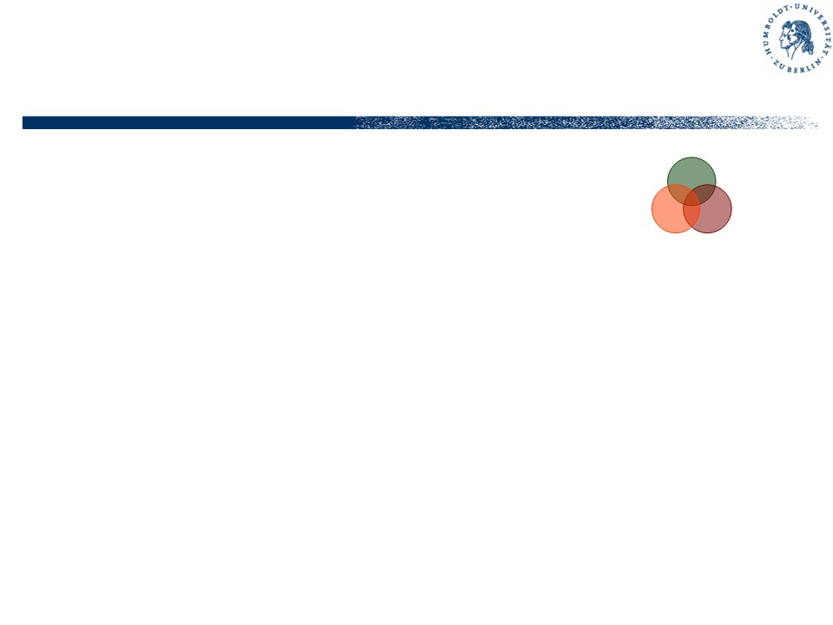
Testing, Validation, Verification
Trying to answer different questions
• Testing: Did we build the software right?
• Validation: Did we build the right software?
• Verification: Can we show that the software is correct?
• Dijkstra: “Testing can only show the presence of bugs, not their absence.”
• Hoare (attributed): “Beware of this program. I haven’t tried it yet, I only proved its correctness.”
Consider two airplanes: One brand new, with verified but untested
software. The other one with software which is thoroughly tested but not verified. Which one would you enter?

Slide 11
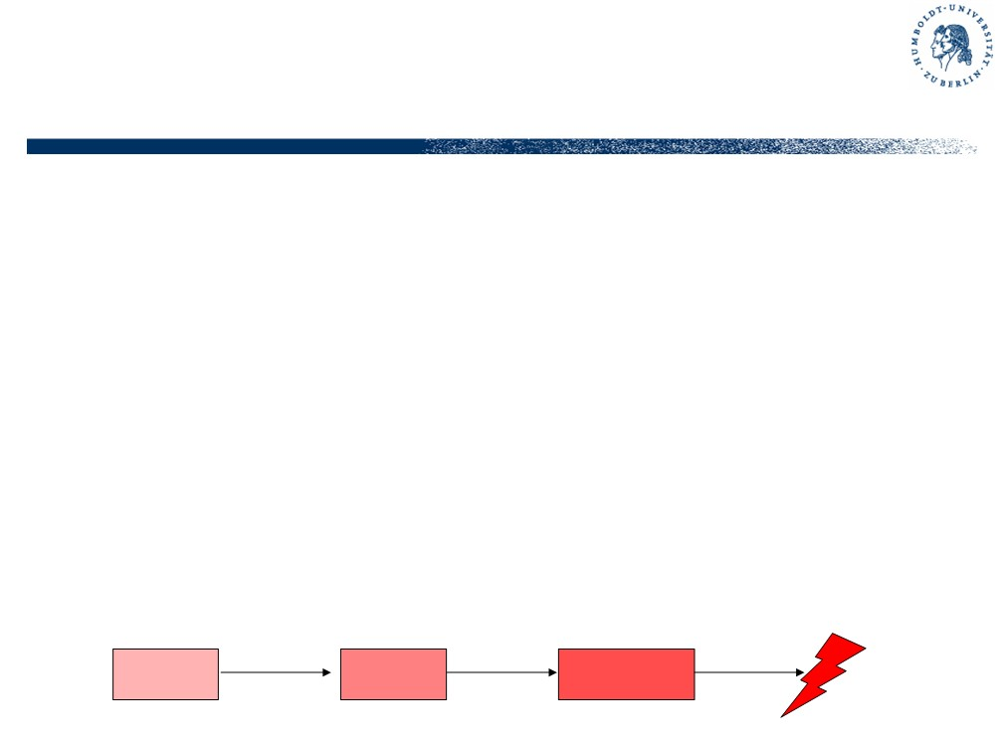
Errors, Faults, Failures
• Error or Mistake - something a person thought or did he/she shouldn’t have (bad idea or action)
• Fault or Defect - something wrong within the design or machine (bad state or flaw), due to an error during the design or manufacturing process
• Failure - wrong behaviour, malfunction of an artefact due to the activation of a fault
• Incident or Accident - visible effect of a failure
onto the environment of the system, esp. on people
Error
Fault
Failure

Slide 12
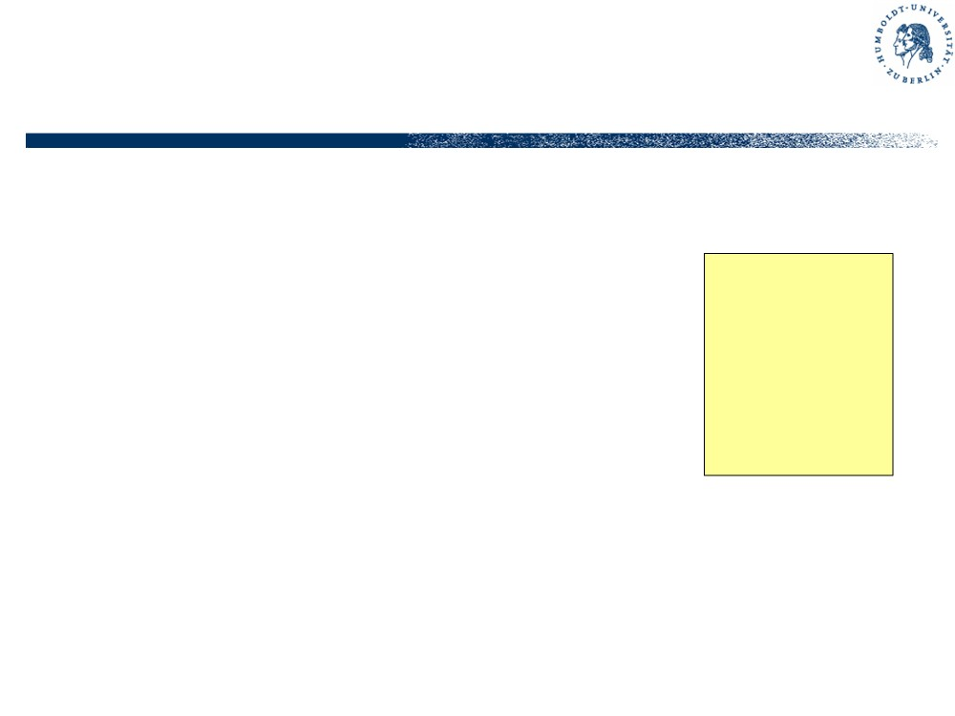
Tests, Test Cases and Test Suites
• Test - the execution of a test case
• Test Case - an entity identifying preconditions, inputs and expected
Test Case A34871
Table lookup mod_admin
outputs or postconditions for a particular SUT behaviour
Pre: n_usr>0 In: uid = 0x5f0e Out: uname =“abc” Post: tbl=tbl’
• Test Suite - set of test cases for a particular testing objective (quality
measure), usually with common points of observation and control (PCOs) in the SUT
• Test Design - the construction of test suites

Slide 13
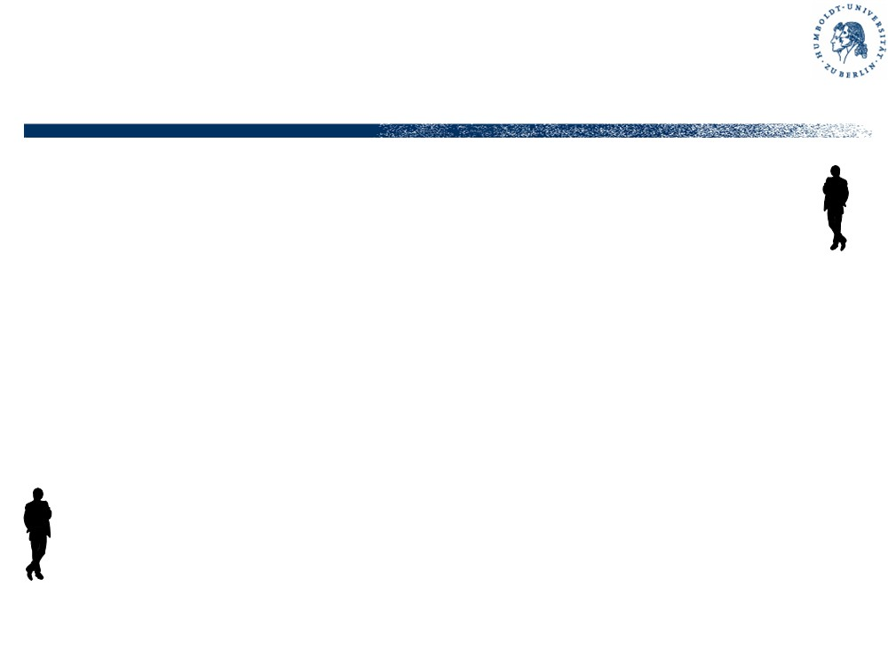
Implementation and Testing
• “Programmer” and “Tester” are fundamentally different roles
§ programmer wants to show correctness of his creation
§ tester has the task to find errors, i.e. testing is successful if it uncovers deficiencies
• “Programmer” and “Tester” are essentially similar roles
§ programmer creates executable artefacts (programs) from specifications
§ tester creates executable artefacts (test suites) from specifications

Slide 14
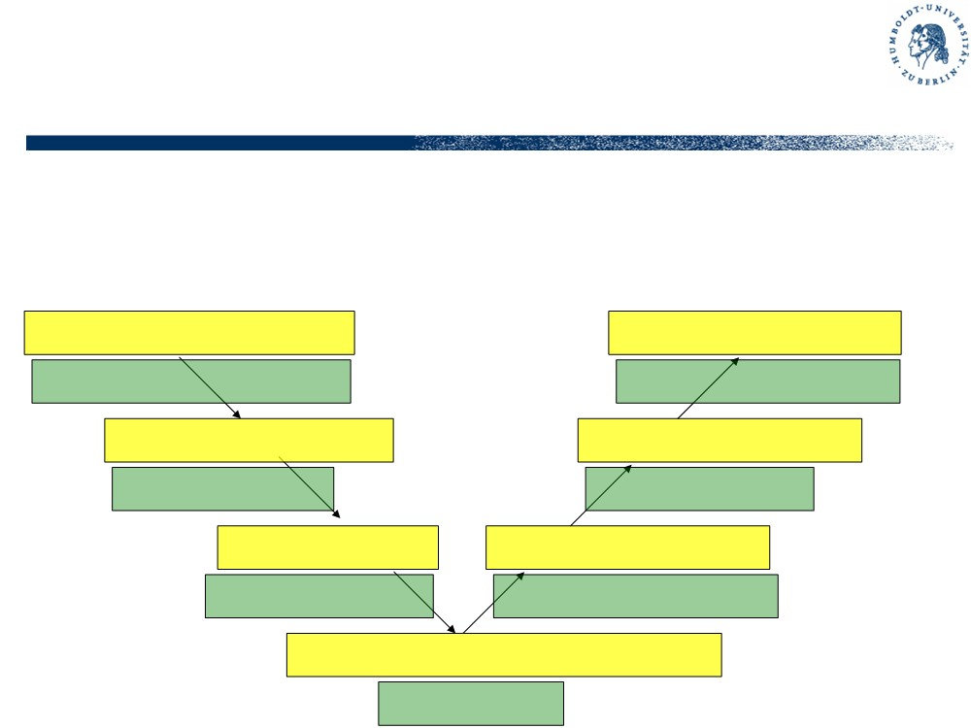
Implementation and Testing
• V-Model: constructive and analytical part of software life cycle
Requirements Analysis Requirements Testing
System Deployment Acceptance Testing System Integration
Architecture Design Design Testing
System Testing Module Integration
Module Design Module Testing
Integration Testing
Unit Design & Implementation Unit Testing

Slide 15
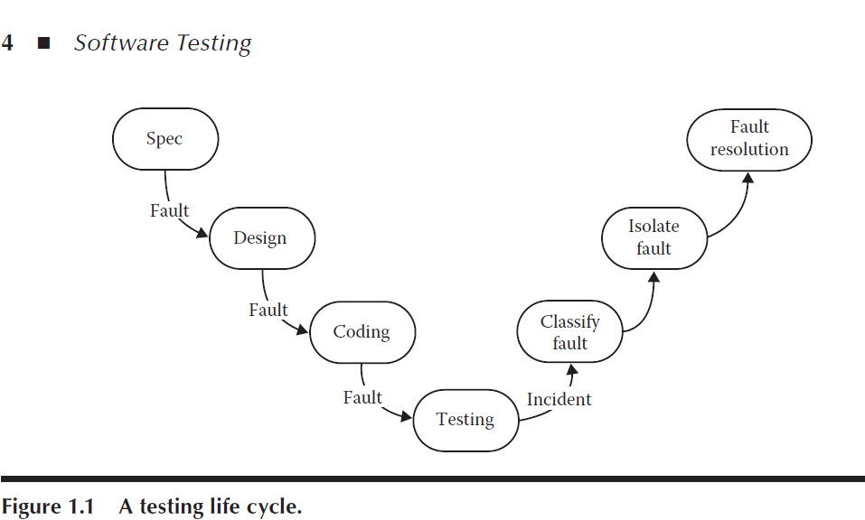

Slide 16
Classification of Testing (1)
• According to system life-cycle or structure
§ analysis, design, implementation, integration, deployment
§ module/unit, component, system, user
• According to class of SUT
§ operating system, middleware, driver, library, application, GUI, web-service, embedded software, ...
• According to testing method / test selection method
§ static or dynamic, structural or functional, control- or data oriented, single or regression test, ...

Slide 17
Classification of Testing (2)
• According to testing purpose or objective
§ functional testing, acceptance test, usability test, load test, interoperability test, safety test, …
• According to available information and specification method
§ Black-Box, White-Box, Grey-Box
§ UML-/model based, contract/requirement based, style guide based, formal specifications, …
• According to tool use and degree of automation:
§ manual or automatic (scripted) test execution, test case generation, test evaluation, management and documentation

Slide 18
Levels of Testing
• User level: requirements test, rapid prototyping,
usability test, installation and configuration test, load and stress test
• System level: system test, design test, module
interaction test, acceptance test, back-to-back-test, GUI testing, performance and robustness test
• Module level: module test, integration test,
communication test, data flow test, data integrity test, cause-effect test
• Unit level: unit test, logic test, equivalence class
test, boundary value test, control flow test, loop test

Slide 19
Testing Tools
• Like any other software engineering activity, the effectiveness and efficiency of testing highly depends on the tools deployed
• www.testingfaqs.org lists more than 500 (!) tools in the following categories
§ Unit test tools
§ Test drivers, test suite management
§ Test implementation, static analysis
§ Test design tools, test coverage monitors
§ Load and performance testing
§ GUI test drivers
§ Defect tracking systems, bundled suites

Slide 20
Testing languages
Several languages are being used for writing down test cases
§ .doc (esp. for manual test execution)
§ MS Excel or .txt, .csv etc. (tabular notation)
§ csh, .bat (command-line SUT)
§ Perl, Python, AWK, Tcl, …
§ C, C++
§ language of the SUT
§ TSL, TestML
§ TTCN-3
§ …

Slide 21
§ Examples
- The triangle problem
- The NextDate function
- The commission problem
- The automated teller machine
- The currency converter
- The windshield-wiper controller

Slide 22
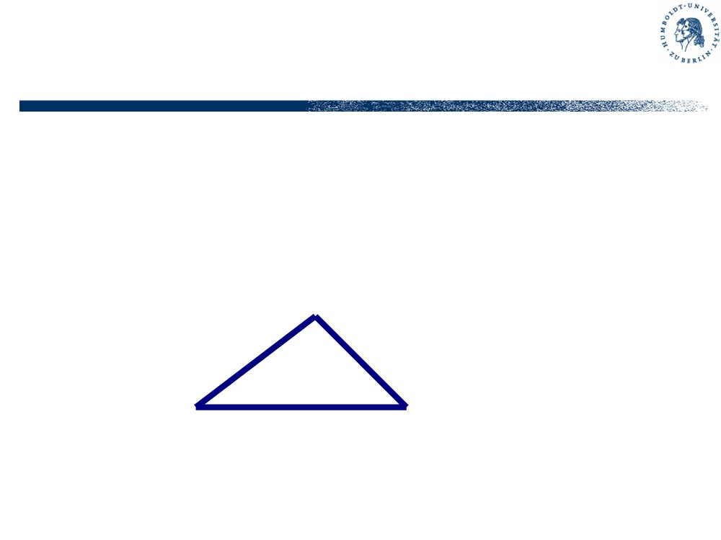
The Triangle Problem
• Function triangle takes three integers a,b,c which are length of triangle sides; calculates whether the triangle is equilateral, isosceles, or scalene.
• The task is to write down test cases for this function
• “Classical” testing task (Myers)

Slide 23
Evaluation
Each “yes” gives you one point
• Do you have a test case for an equilateral triangle?
• Do you have a test case for an isoscele triangle? (must be a triangle, not, e.g. (2,2,4))
• Do you have a test case for an admissible scalene triangle (must be a real triangle, not, e.g. (1,2,3))
• Do you have at least three test cases for isoscele triangles, where all permutations of sides are considered? (e.g. (3,3,4), (3,4,3), (4,3,3))
• Did you state for each test case the expected result?

Slide 24
Evaluation (2)
• Do you have a test case with one side zero?
• Do you have a test case with negative values?
• Do you have a test case where the sum of two sides equals the third one? (e.g. (1,2,3))
• Do you have at least three test cases for such non- triangles, where all permutations of sides are considered? (e.g. (1,2,3), (1,3,2), (3,1,2))
• Do you have a test case where the sum of the two smaller inputs is greater than the third one?
• Do you have at least three such test cases?

Slide 25
Evaluation (3)
• Do you have the test case (0,0,0)?
• Do you have test cases with very large integers (maxint)?
• Do you have a test case with non-integer values? (e.g., real numbers, hex values, strings,…)
• Do you have a test case where 2 or 4 inputs are provided?
Average programmer’s score 7-8 points
Myers 1979: this example should demonstrate that testing even a trivial program is not an easy task. Consider the problem of testing an air traffic guidance system with
100.000 instructions, a compiler or just a payroll program.

Slide 26
Improved Triangle Problem
• The program accepts three integers between 1 and 200 which satisfy the triangle inequalities. The output is the type of triangle determined by the three sides.
• If the input does not match the range requirements, the program issues an error message and aborts.
• If the input does not satisfy the triangle inequalities, the program output is “NotATriangle”
• Otherwise, the output is
§ “Equilateral”, if all three inputs are equal
§ “Isosceles”, if exactly one pair of inputs is equal
§ “Scalene”, if all inputs are pairwise unequal

Slide 27
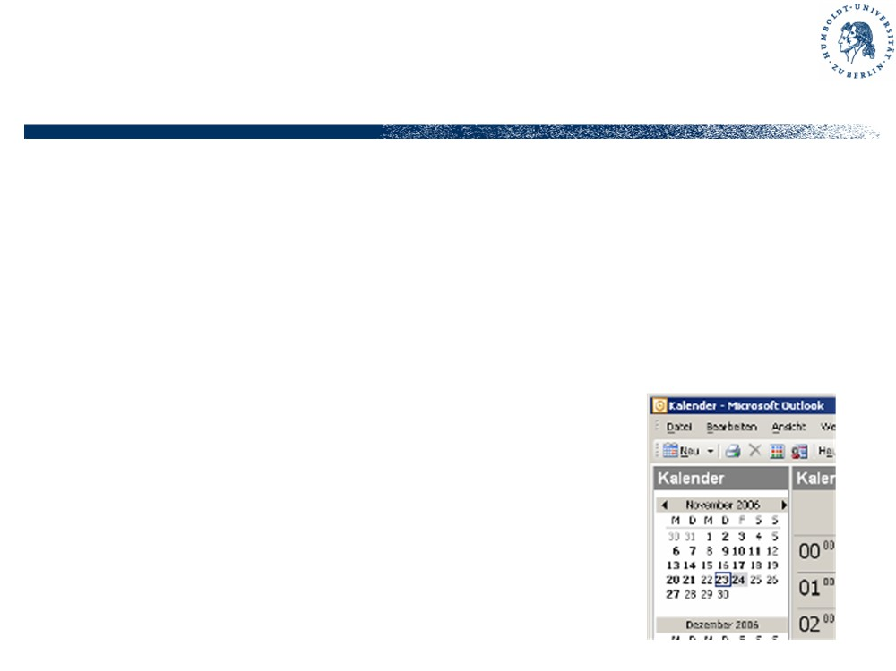
Second Example: NextDate
• A “date” consists of three integers: month, date, year
• NextDate takes a date and returns the date of the following day
§ Checks whether input date is valid (according to Gregorian calender, no Feb 31st etc.)
§ Return value respects leap years etc.
• Two sources of complexity
§ input domain check
§ rules of leap years

Slide 28
DaysInMonth
• 30+((m mod 2) xor (m div 8))-n*(n==2)
• if m==2 then 28
else if m<7 and even(m) or m>7 and odd(m) then 30 else 31
• if m==2 then 28
else if m in {4,6,9,11} then 30 else 31
• array
DiM=[31,28,31,30,31,30,31,31,30,31,30,31] return DiM[month]

Slide 29
Rules for Leap Years
• One year is approximately 365.2422 days
• Julius Caesar: every fourth year is a leap year
• Pope Gregory in 1582 reformed Caesarian rules
• Year is leap year if divisible by 4 but not by 100, or if divisible by 400. Thus 1600, 2000, 2004 and 2008 are leap years, but 1700, 1900 and 2100 are not.
• Leap seconds due to slow-down of earth rotation… Homework: implement and test the NextDate function!

Slide 30
Third Example: Commission Problem
• Rifle sales company produces
§ locks $45
§ stocks $30
§ barrels $25
• Salesmen send sales reports via telegraph; commission is 10% on sales up to $1000, 15% on the next $800, 20% on everything above
• Program produces monthly sales reports and commission to be paid
• typical commercial application, mix of computation and
decision, input stream, output table(?), functional behaviour

Slide 31
Fourth example: SATM
• “Simplified Automated Teller Machine”
• One of those common money distributors
§ Screen display, numerical keypad, card reader, cash dispensing unit, (receipt printer)
• Specification mostly given by screenshots (“rapid prototyping”)
§ implicit information, e.g. which bills are available
• State-transition system
§ not much calculation
§ user interaction
§ Client-server paradigm

Slide 32
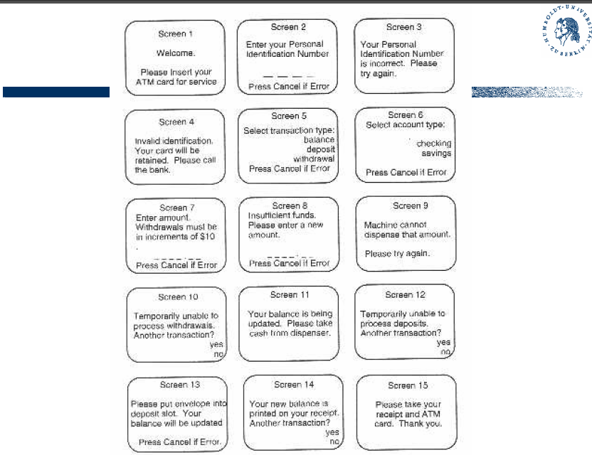

Slide 33
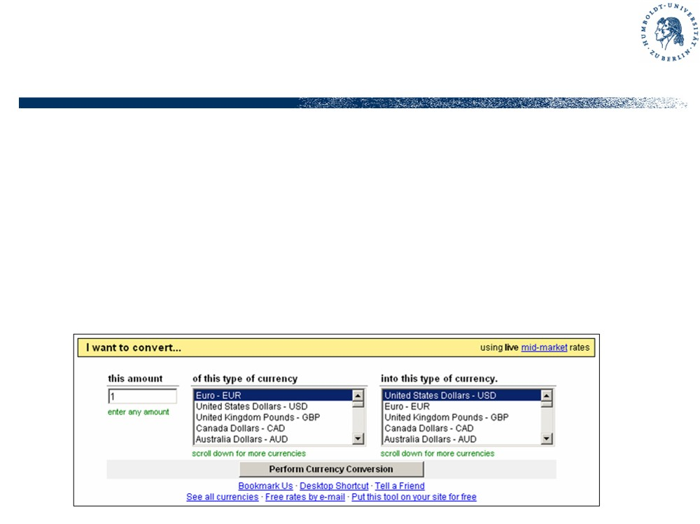
Fifth example: Currency converter
• Example of GUI (graphical user interface) program
§ text fields, radio buttons, …
• Web-based, web-service

Slide 34
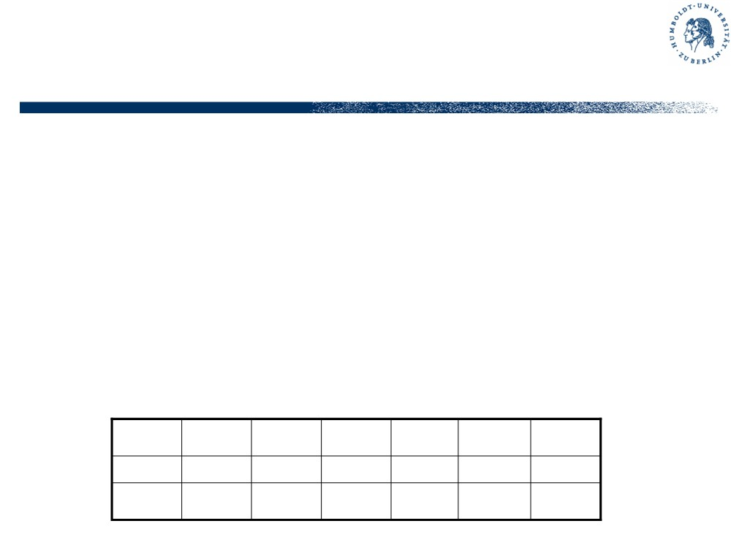
Last example: Windshield wiper controller
• Embedded control system
§ Reactive system, continuous interaction
§ Real-time properties
• Input: lever and dial setting, bus signals Output: motor signals / voltages
• Problems: Interfacing, HiL-Testing
Lever
OFF
INT
INT
INT
LOW
HIGH
Dial
n/a
1
2
3
n/a
n/a
Wiper
0
4
6
12
30
60

